Slide 1

Vel Tech Rangarajan Dr. Sagunthala R&D Institute of Science and Technology
School of Computing
Department of Computer Science and Engineering
10211CS224 / FULL STACK APPLICATION DEVELOPMENT (JAVA)
PROJECT REVIEW : MILESTONE PROJECT – 2
Date: 20-04-2026
Design and develop a React JS based web application for Ticket Booking of an Internal Department Event
SDG: SDG No – SDG Title(Example: SDG 4 – Quality Education)
Presented By:
P. AARON SATHWIK – VTU26637 – 23UECS1165.
Courses Handling Faculty:
Dr. Nateshan N.V.S

Slide 2
.
INTRODUCTION
A React JS web app is developed for internal department event ticket booking.
It provides a simple and user-friendly interface for users.
Users can view available events and their details easily.
The system allows quick and efficient ticket booking.
It displays real-time seat availability and pricing.
Users can confirm bookings with minimal steps.
The application helps manage event registrations smoothly.
It reduces manual work in ticket handling.
It ensures an organized and efficient booking process.
.
1
2
3
4
5
6
7
8
9

Slide 3
PROBLEM STATEMENT
Existing internal department event booking processes are mostly manual, making them slow and inefficient.
Organizers often use separate tools, leading to data inconsistency and errors.
There is no centralized system to track bookings and availability in real time.
Users face difficulty in easily viewing and reserving event tickets.
A simple, integrated React JS application is needed to streamline the booking process.
1
2
3
4
5
6
7
8
9

Slide 4
OBJECTIVE(S)
1
2
To design and develop a React JS based internal department event ticket booking application that enables easy creation, viewing, and booking of event tickets in a centralized and user-friendly platform. To provide seamless access across devices, ensuring convenience for both users and organizers.
To ensure efficient management of event registrations by providing real-time updates, reducing manual effort, minimizing errors, and improving the overall event booking and management experience. To enhance reliability and scalability of the system for handling multiple users and events simultaneously
3
4
5
.
6
7
8
9

Slide 5
PROPOSED SYSTEM
Unified Event Management – A single React JS based application that combines event listing, ticket booking, and registration management, eliminating the need for multiple manual methods.
Automated Ticketing & Fraud Prevention – Digital ticket generation with instant confirmation, reducing manual errors and simplifying the booking process.
Real-Time Analytics Dashboard – Live tracking of ticket availability and user registrations for better event management and planning.
Contactless Access Control –Simple and responsive design that allows users to easily browse events and book tickets across devices.
How It Solves Existing Issues –Replaces manual and scattered booking methods with a centralized system, reducing errors, saving time, and improving efficiency.
Advantages Over Current Systems – Provides a single platform for all booking activities, ensures real-time updates, and delivers a smoother and more reliable user experience.
1
2
3
4
5
6
7
8
9

Slide 6
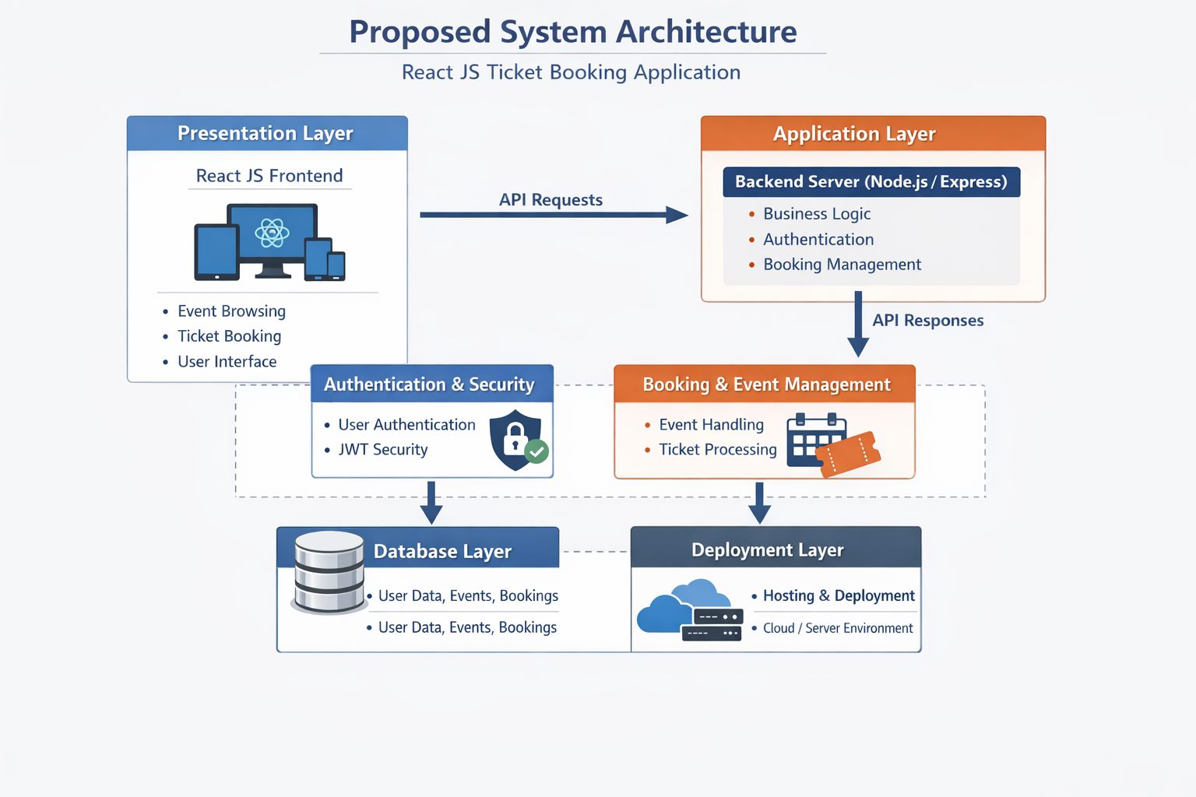
PROPOSED SYSTEM ARCHITECTURE
1
2
3
4
5
6
7
8
9

Slide 7
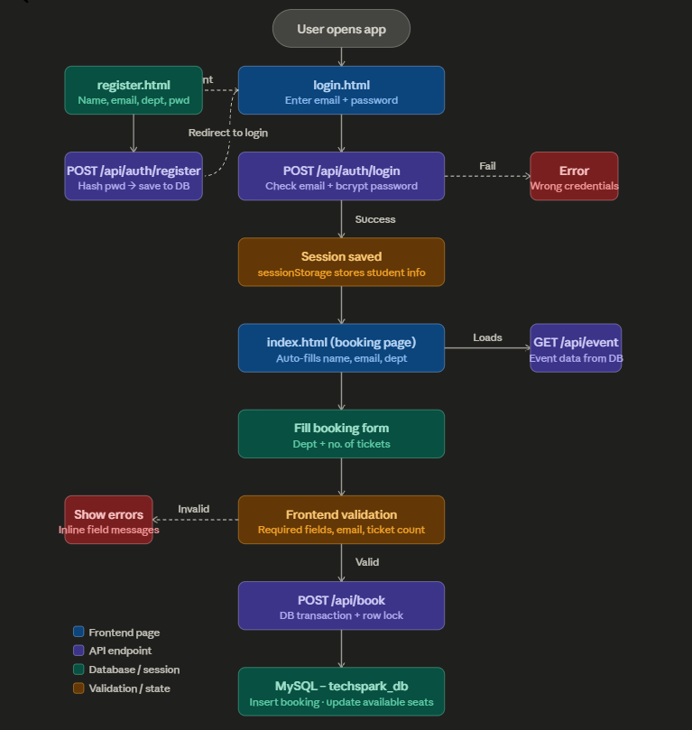
WORKFLOW
1
2
3
4
5
6
7
8
9

Slide 8
TECHNOLOGIES USED
Frontend: HTML, CSS, JavaScript, React.js
Backend: Node.js (VS Code + CMD)
Database: MySQL
Tools: VS Code, CMD
Hardware: Laptop, Internet,
Software: VS Code, Node.js, MySQL, Web Browser
Database Tables:** Events, Booking, Students
1
2
3
4
5
6
7
8
9

Slide 9
MODULE DESCRIPTION
Module 1: User Management Handles user registration, login, and basic profile management with secure authentication for attendees and organizers.
Module 2: Event Management Manages creation of internal events, event details, schedules, and capacity settings by organizers
Module 3: Ticket Booking Handles ticket selection, booking process, and instant confirmation for users.
Module 4: Booking Management Manages viewing of booked tickets, cancellations, and updates for users and organizers.
Module 5: Database Management Handles storage and retrieval of data related to users, events, and bookings efficiently.
Module 6: Dashboard & Tracking Provides simple tracking of registrations and event participation for organizers
1
2
3
4
5
6
7
8
9

Slide 10
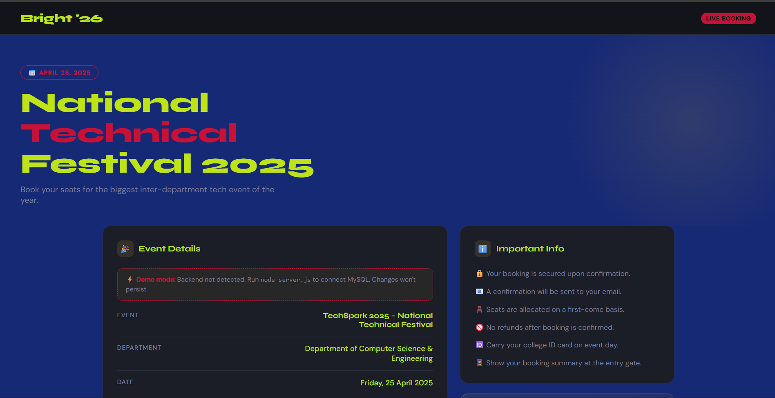
IMPLEMENTATION SCREENSHOTS
1
2
3
4
5
6
7
8
9

Slide 11
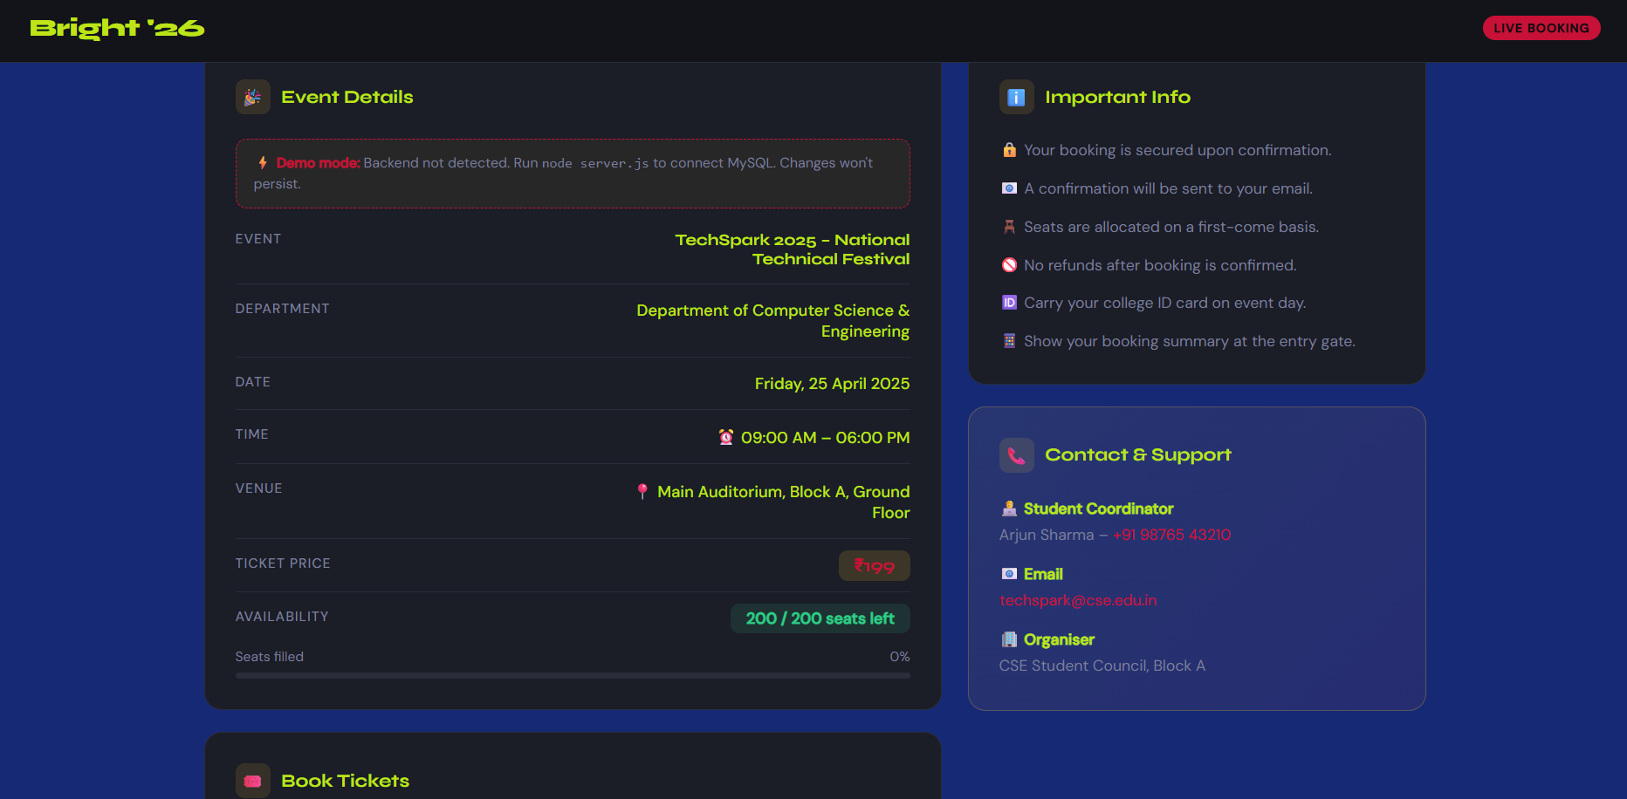
IMPLEMENTATION SCREENSHOTS
1
2
3
4
5
6
7
8(A)
9

Slide 12
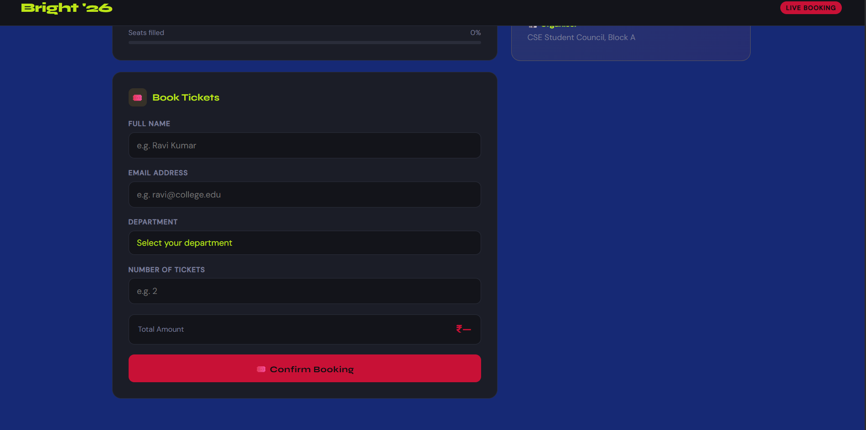
IMPLEMENTATION SCREENSHOTS
1
2
3
4
5
6
7
8(B)
9

Slide 13
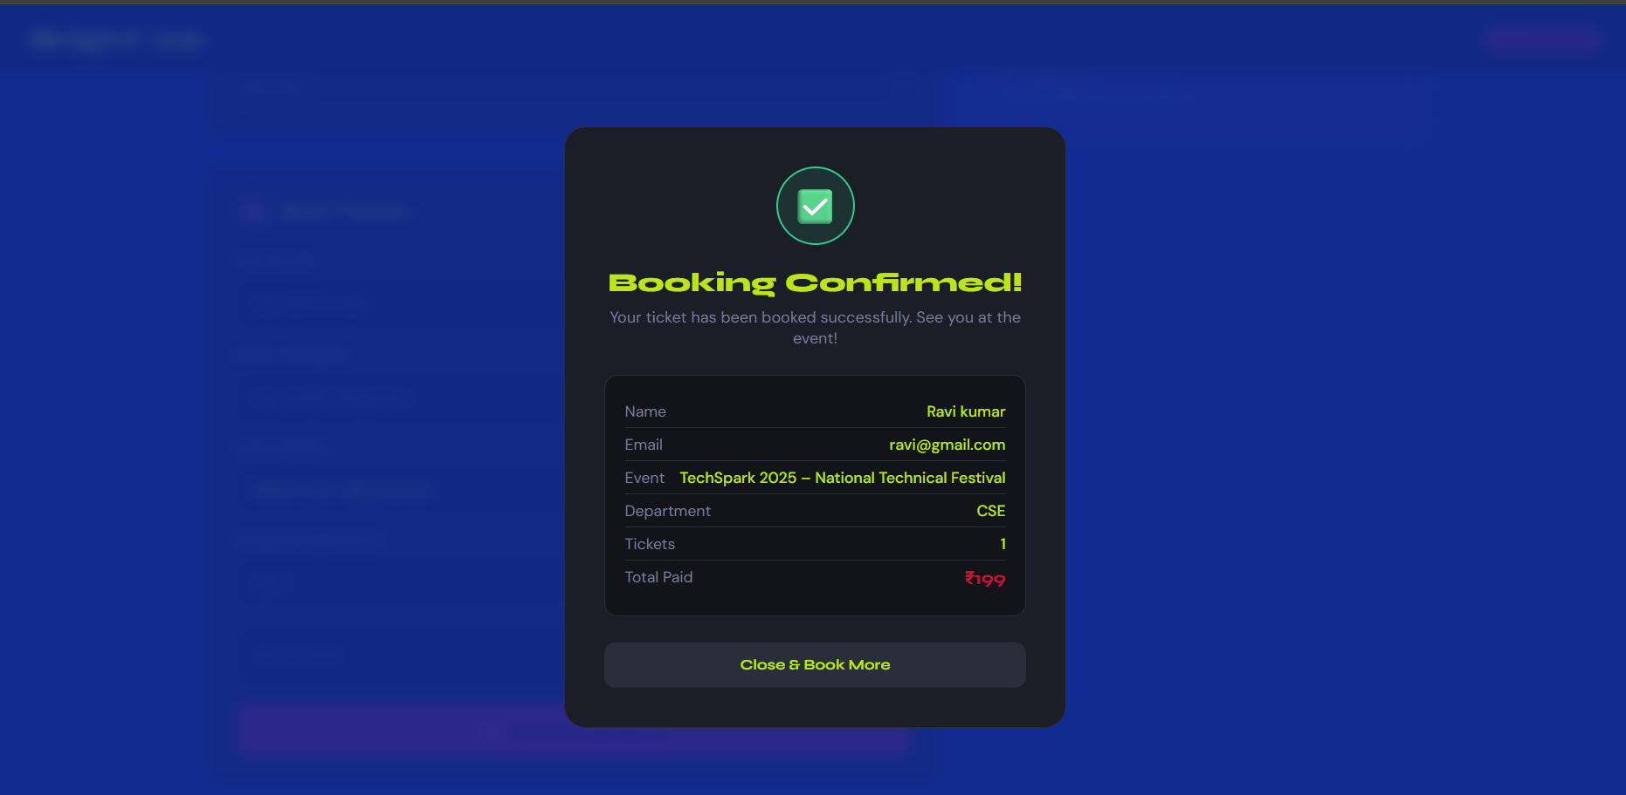
IMPLEMENTATION SCREENSHOTS
1
2
3
4
5
6
7
8(C)
9

Slide 14
ADVANTAGES & LIMITATIONS
Advantages
Provides a centralized platform for internal event ticket booking and management
Reduces manual work and minimizes human errors
Enables real-time tracking of bookings and availability
Offers a simple and user-friendly interface for easy access
Improves efficiency in managing event registrations
Allows quick booking and confirmation process
Limitations
Limited to internal department use only
Depends on internet connectivity for access
Basic security features compared to large-scale systems
May not support advanced payment integration (if not implemented)
Scalability can be limited for very large events
Requires regular maintenance and updates
1
2
3
4
5
6
7
8
9

Slide 15
Thank you

